Slide 1
TBADCG²E: Architecture
Greg De LA Torre
Christian Robles
Troy Redfearn
Farouk Nuseibeh
Jonathan luna

Slide 2
Dungeons & Dilemmas
Dungeons and Dilemmas is a text based adventure/dungeon crawler. The player will attempt to complete a series of randomly generated dungeons that get increasingly difficult with each successful clear.
Each dungeon will contain monsters, traps, and puzzles for the player to overcome in order to gather treasure.
The game plays until the player dies, and the player will die. After dying the player will be given a score based on treasure gathered and dungeons cleared.

Slide 3
Architectural Drivers
Linked list core.
“Event” style processing of data.
Interaction between multiple classes.
Player input

Slide 4
Architectural Choices
Client Server
Repository
Player input acts as the client.
Core Game file acts as the server.
The server will send data back to the client in the form of “Events” which prompts the client to submit further input.
Through further Player Input (client), the Player proceeds through the game.
This style fits with how the game is designed and played.
Maze object acts as a traditional repository of Events.
An active repository style has similar functionality to client-server for our game.
Player input acts as reactive access, and the repository returns an Event based on other data stored in the Maze object.
Events act as their own traditional repositories of additional data.
We decided to utilize the repository architectural style, due to it better showing how we want to design the game and how we want the game to function.

Slide 5
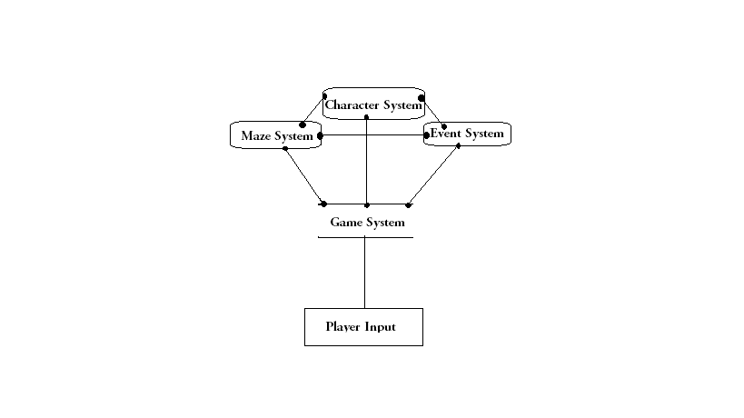

Slide 6
Conclusion
Repository style was chosen to better match our design ideals
Data interaction and reading may be more time consuming with this style.
Time is of the essence!
Questions?

